Slide 1
AI-Based Climate Risk Assessment for Agriculture Agentic AI Hackathon – IBM Granite & Langflow

Slide 2

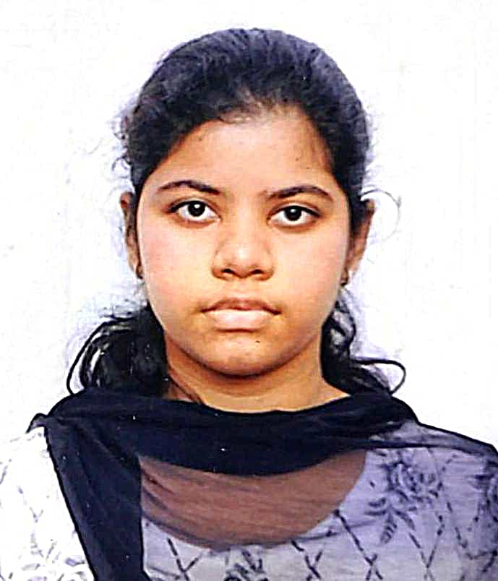
Name of the team: TEAM B
Details of Team members
TEAM MEMBER NAME | Recent Passport Photo | Email ID | Phone number [WhatsApp]
Yuvan B |  | yuvanchaudary2004@gmail.com | 8722451693
Dhathri |  | dhathrimuppuri06@gmail.com | 7981311489

Slide 3
Problem statement
Agriculture is extremely vulnerable to climate variability such as droughts, floods, heatwaves, and irregular rainfall. Farmers often lack access to accurate, localized, and actionable climate risk insights.
Key challenges include:
Complex and fragmented climate data
No early warning for climate risks
Lack of decision-ready insights
High dependency on manual expertise
This leads to crop loss, reduced yield, and financial instability for farmers.

Slide 4
Proposed solution
We propose an AI-Based Climate Risk Assessment System using an Agentic AI architecture deployed fully on IBM Cloud.
The system:
Collects climate and historical agricultural data
Uses AI agents to analyze climate risks
Generates crop- and region-specific risk assessments
Provides actionable advisory insights in natural language
This enables farmers and stakeholders to take preventive and informed decisions.

Slide 5
Need of project
The project is required to:
Detect climate risks at an early stage
Reduce crop failure and yield loss
Improve sustainable farming practices
Convert raw climate data into clear recommendations
Support climate-resilient agriculture

Slide 6
End user of project
Farmers (small, medium, large-scale)
Agricultural officers
Government agricultural departments
Crop insurance providers
Agri-tech solution providers

Slide 7
Technology Used
BM Watsonx.ai – AI model hosting & governance
IBM Granite Foundation Model – Climate reasoning & risk analysis
Langflow (IBM Cloud deployment) – Agent orchestration
IBM Cloud Object Storage – Climate & historical datasets
IBM Watsonx.ai Prompt Lab – Prompt engineering
IBM Cloud RAG Architecture – Context-aware insights

Slide 8
Novelty and Uniqueness
Uses Agentic AI instead of a single AI model
Fully deployed on IBM Cloud ecosystem
Converts climate data into actionable risk scores
Explainable and bias-controlled outputs using IBM Granite
Scalable and adaptable for different crops and regions

Slide 9
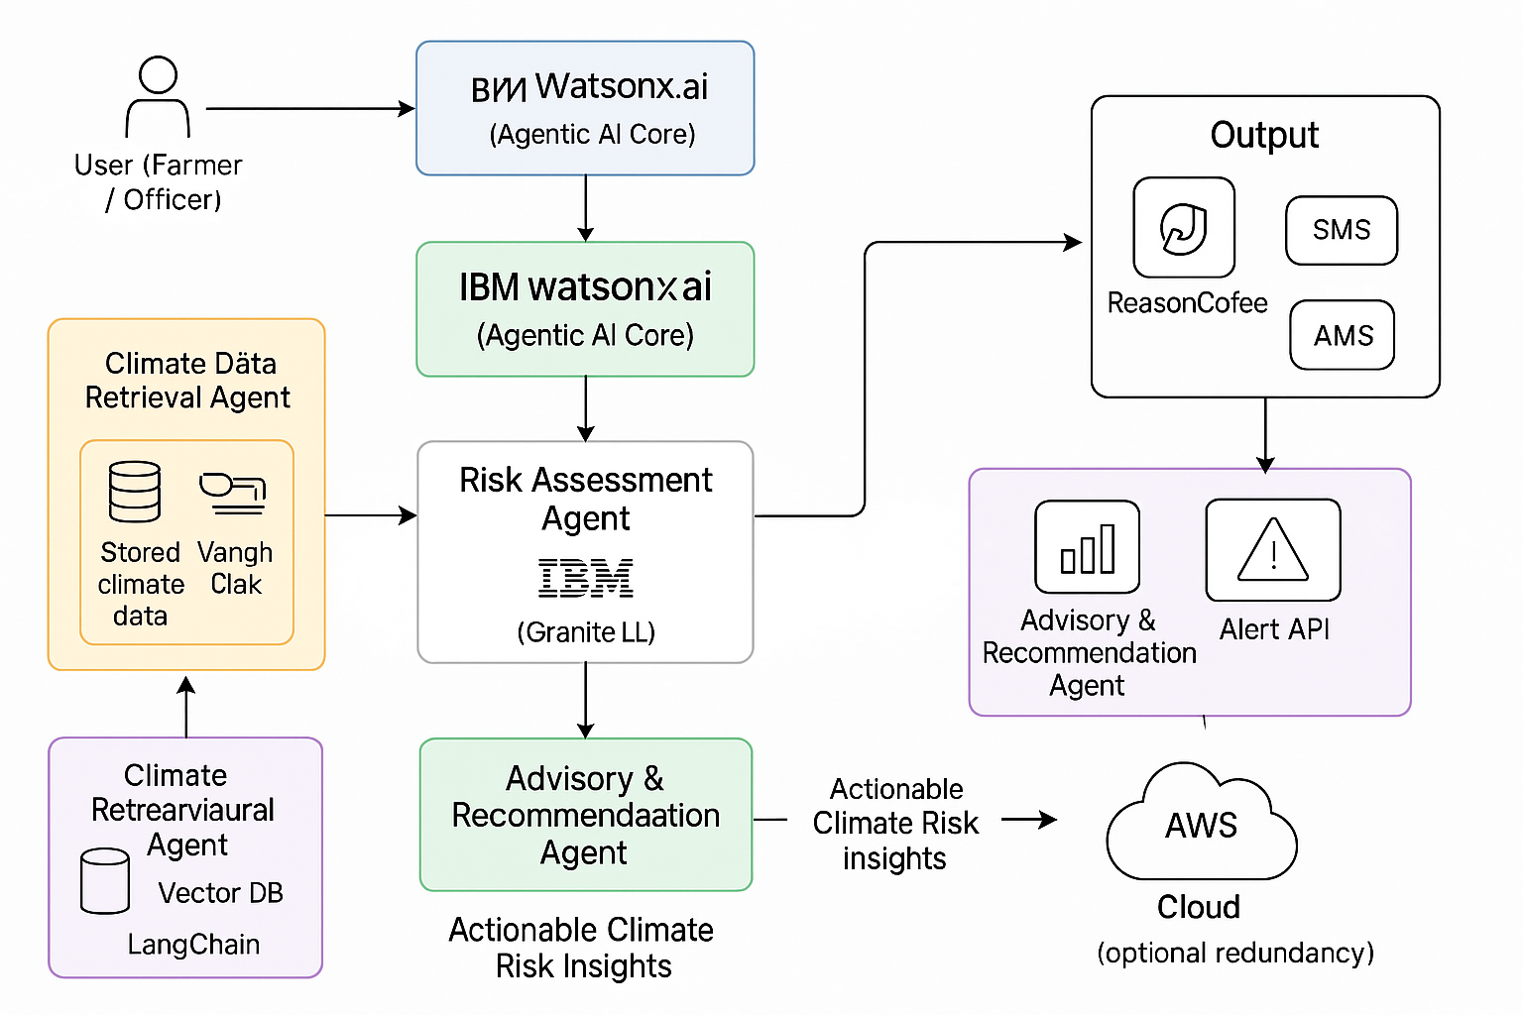
Technical flow diagram - Architecture blueprint

Slide 10
Langflow component Used
1. Chat Input
Accepts user inputs such as:
Location
Crop type
Season
2. IBM Watsonx.ai Agent
Coordinates multiple AI agents
Controls reasoning and task execution
3. Climate Data Retrieval Component
Fetches climate data from IBM Cloud Object Storage
Supports RAG-based grounding
4. IBM Granite Model
Analyzes climate patterns
Generates risk scores and explanations
5. Chat Output
Displays farmer-friendly risk insights
Provides preventive recommendations

Slide 11
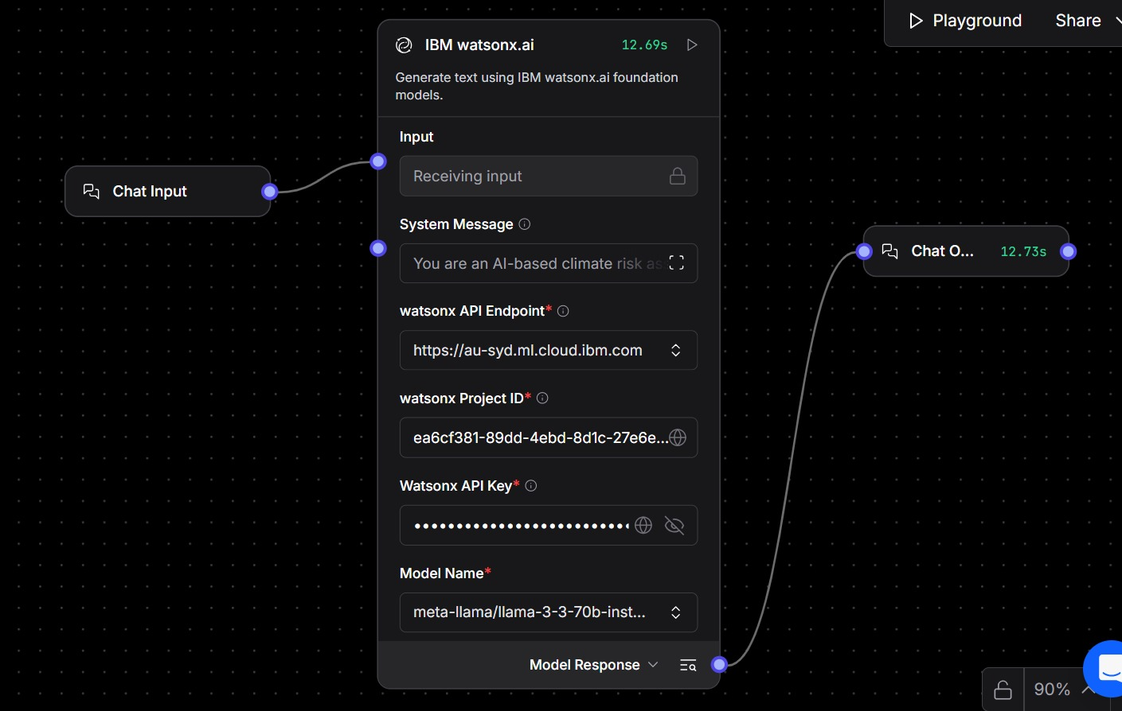
Input Screenshot 1

Slide 12
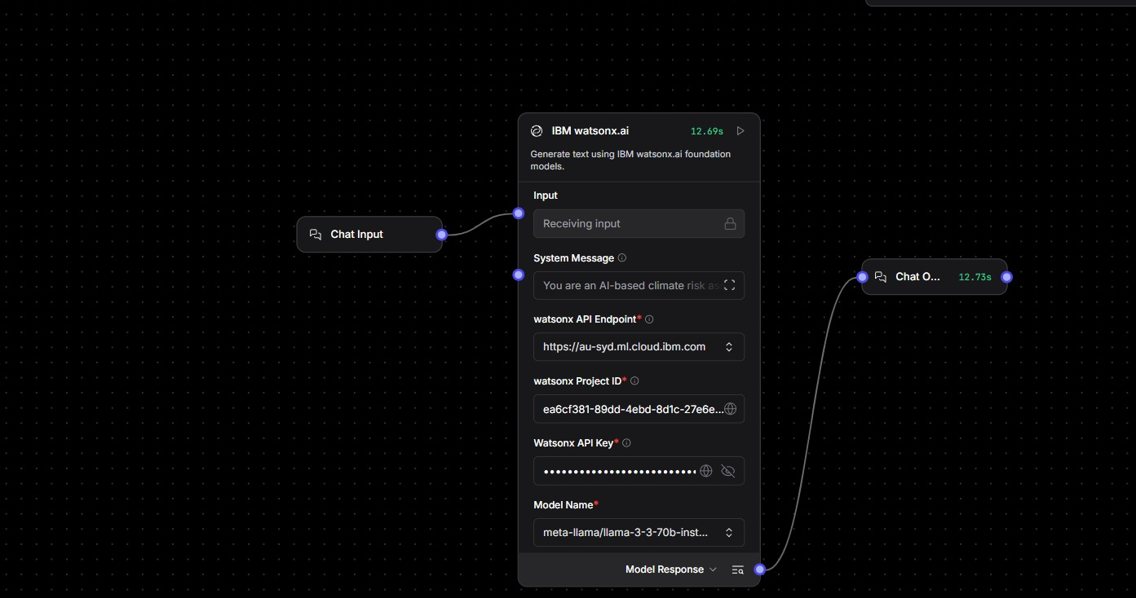
Input Screenshot 2

Slide 13
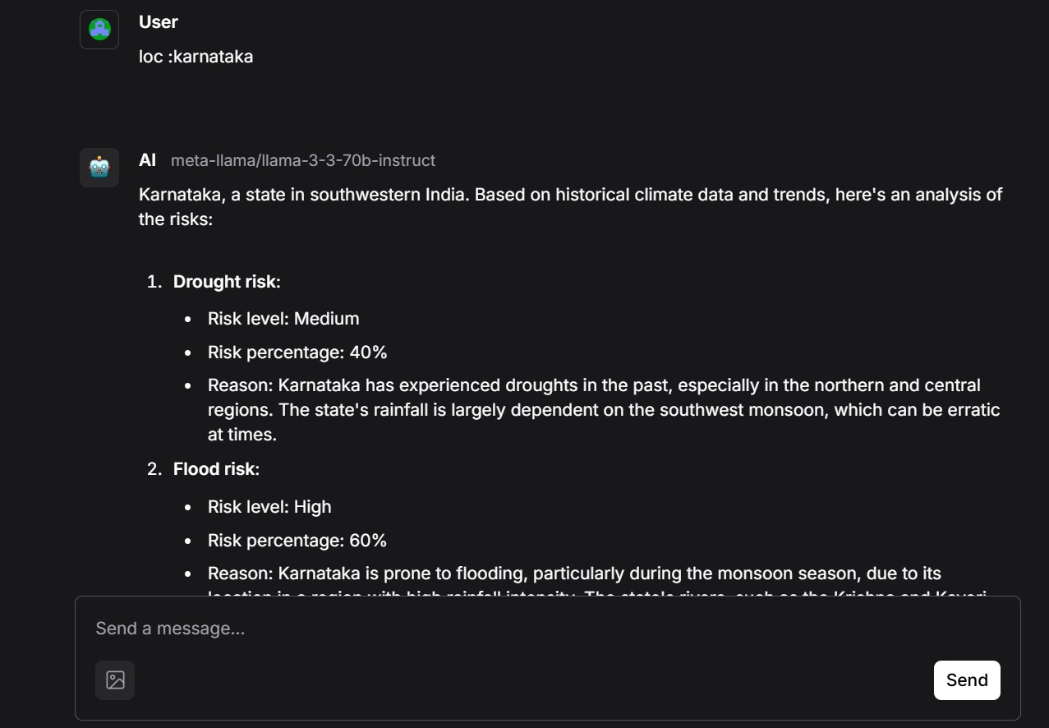
Output Screenshot 1

Slide 14
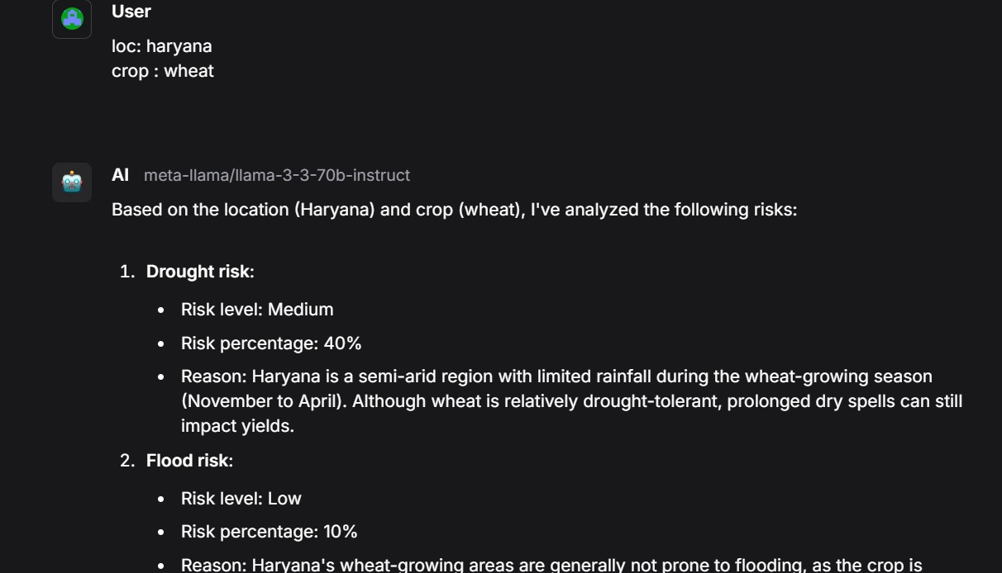
Output Screenshot 2

Slide 15
Future Scope
Real-time climate data integration
Mobile application for farmers
Multi-language support
Crop yield prediction
Climate-aware insurance risk scoring
Government agriculture portal integration
·
·
·

Slide 16
Git Hub Link
· Please create public github repository (Enable Add README button while creating repository) with format –
Please test and Paste the working Github URL – https://github.com/YuvanChaudary/ai-climate-risk-assessment.git
·
·
·

Slide 17
References
IBM Watsonx.ai https://www.ibm.com/products/watsonx-ai
IBM Granite Foundation Models https://www.ibm.com/blog/ibm-granite-models
Agentic AI – IBM Overview https://www.ibm.com/think/topics/agentic-ai
Langflow Documentation https://docs.langflow.org
FAO – Climate Change & Agriculture https://www.fao.org/climate-change/en
World Bank – Climate Change Knowledge Portal https://climateknowledgeportal.worldbank.org
Explainable AI (XAI) – IBM https://www.ibm.com/topics/explainable-ai
Retrieval-Augmented Generation (RAG) – IBM https://www.ibm.com/think/topics/retrieval-augmented-generation
·
·
·

Slide 18


